Slide 1


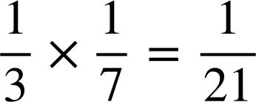

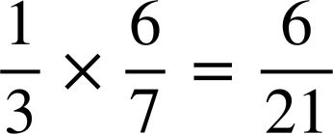
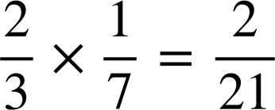

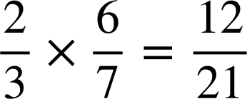











Calculating theoretical probabilities from probability trees (two events)
Task A: Probability of an outcome from a two-stage trial
1) Spinner 1 is spun several times.
The spinner landed on R
of the time.
Spinner 2 is spun several times.
The spinner landed on G
of the time.
Trial: spinning spinner 1 and spinner 2 once each.
Complete the probability tree to calculate the probability of each outcome from this trial.
G
R G
R
H
R H
R
G
G
T G
T
H
spinner 1
spinner 2
T
T H
H
2) Trial: spinner 1 and spinner 2 are spun once each.
This probability tree currently shows all the outcomes on spinner 1.
a)
B
A B
A
b) What is the probability of the outcome C Q happening?
Q
A Q
C
B
C B
T
T
A
C
Q
B
Q
C Q
A
A
T
A
B
Q
T
B
T B
B
spinner 1
spinner 2
Q
T Q

Slide 2
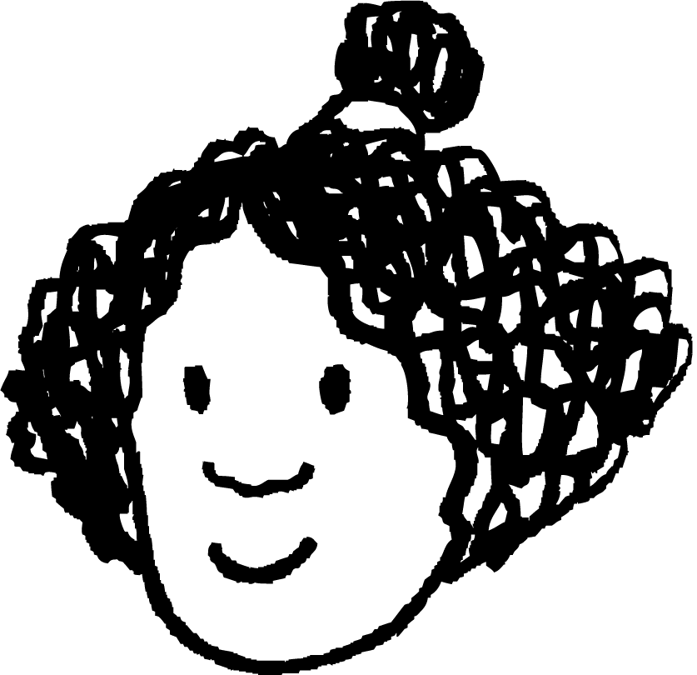










Calculating theoretical probabilities from probability trees (two events)
3) Lucas, Izzy, and Laura each take two flower seeds from a packet to grow.
The probability of each type of flower growing is written on the packet.
2 roses
1 violet
1 daisy
1 rose
1 daisy
Izzy
Lucas
Laura
90%
grow
violet grows
daisy grows
80%
grow
72%
violet: 80%
Lucas’ tree
10%
not
grow
violet grows
daisy doesn’t grow
8%
rose:
90%
grow
violet doesn’t grow
daisy grows
20%
not
grow
18%
daisy: 90%
stage: plant the violet seed
10%
not
grow
violet doesn’t grow
daisy doesn’t grow
daisy
2%
Izzy’s tree
Laura’s tree
grow
two roses grow
90%
grow
rose grows
daisy grows
grow
grow
67.5%
not
grow
first rose grows
10%
not
grow
rose grows
daisy doesn’t grow
second rose grows
7.5%
grow
90%
grow
rose doesn’t grow
daisy grows
not
grow
neither rose grows
not
grow
22.5%
rose
not
grow
rose
10%
not
grow
rose doesn’t grow
daisy doesn’t grow
rose
2.5%
daisy
Task B: Probability of an event from a two-stage trial
1) A coin is flipped several times. On 45% (or 0.45 as a decimal) of trials, the coin lands on heads. Trial: flipping this coin twice.
0.45
head
a) What is the probability of the outcome “two heads”?
head
head
head
0.2025
0.2025
0.45
0.55
tail
0.2475
b) What is the probability of the event that at least one coin lands on a heads?
head
tail
0.45
head
tail
head
0.2475
0.2025 + 2 × 0.2475 = 0.6975
0.55
c) What is the probability of the event that exactly one coin lands on a tails?
tail
0.55
tail
tail
0.3025
0.2475 + 0.2475 = 0.495
tail

Slide 3



Calculating theoretical probabilities from probability trees (two events)
2) A different coin is flipped several times. On 53% (or 0.53 as a decimal) of trials, the coin lands on heads. Trial: flipping this coin twice.
0.53
head
Event 1: landing on heads twice.
Event 2: landing on exactly one head.
head
head
head
0.2809
0.53
0.47
tail
0.2491
Event 1: 0.2809
Event 2:
0.2491 + 0.2491 = 0.4982
Event 2 is more likely, by 0.2173 (or 21.73%).
head
tail
0.47
0.53
head
tail
head
0.2491
tail
0.47
tail
tail
tail
0.2209
3) Lucas is playing a video game, and needs to scare away a cowboy using either his dragon or unicorn.
The probability of a character hitting their opponent is shown by their “accuracy” stat.
In order for Lucas to scare away the cowboy, either Lucas’ character has to hit, or the cowboy has to miss (or both).
By constructing two probability trees, find out whether the dragon or unicorn is more likely to scare away the cowboy.
dragon
accuracy: 80%
cowboy
accuracy: 60%
unicorn
accuracy: 60%
cowboy
accuracy: 25%
dragon hits
0.6
cowboy
hits
dragon ✔
cowboy ✔
0.48
unicorn
hits
0.25
cowboy
hits
unicorn ✔
cowboy ✔
0.15
0.8
0.4
cowboy
misses
dragon ✔
cowboy ✘
0.32
0.6
0.75
cowboy
misses
unicorn ✔
cowboy ✘
0.45
0.2
0.6
cowboy
hits
dragon ✘
cowboy ✔
0.12
0.4
0.25
cowboy
hits
unicorn ✘
cowboy ✔
0.1
dragon misses
0.08
unicornmisses
0.3
0.4
cowboy
misses
dragon ✘
cowboy ✘
0.75
cowboy
misses
unicorn ✘
cowboy ✘
The probability that the dragon hits or the cowboy misses is:
0.48 + 0.32 + 0.08 = 0.88
The probability that the unicorn hits or the cowboy misses is:
0.15 + 0.45 + 0.3 = 0.9
Lucas should use the unicorn to scare away the cowboy.
Mathematics in Education and Industry
v2.3

